Slide 1

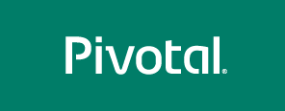
Cloud Native Enterprise
Notes:
test
afdas

Slide 2
Cloud Native Enterprise
Why?
What?
How?
Notes:
I wanted to go over some of these emerging development models and
how tech companies have been successful in moving to these highly composable, resilient application architectures that we’re referring to as cloud native applications.
I want to show you what kind of platform tools the leading tech companies had to build.
And how these new designs are really hitting a lot of enterprises, companies that don’t depend on software directly.
We also want to showcase how these projects work together with a demo of a microservice-based Java app, built with Spring Boot and Netflix OSS projects
Before we turn it over to discussion

Slide 3
WHY
Notes:
Now I’d love to open this up for discussion.

Slide 4

Disruption to Enterprise IT is already here
Notes:
Unix – 1970s Bell Labs
C – 1969 – 1972 at Bell Labs
Java – 1991 @ Sun

Slide 5
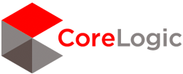


Fortune 500 Companies are Adopting Cloud Native and Microservice Models
“I said to my vendors, I don’t want five years ago. I want five years from now.
“Two people built an app and got it into the App Store in five weeks”
“The adopters we speak to today, like GE, HP, Equinix, PayPal, Capital One, Goldman Sachs, Airbnb, Medallia, Square, and Xoom say that microservices are well worth the tradeoffs.”
Notes:
We’re seeing companies like like Lockheed Martin, BMW and Philips that are incubating cloud-native design in their organizations. These companies are shipping apps to production.
Source: WSJ http://blogs.wsj.com/cio/2015/10/05/innovate-or-die-the-rise-of-microservices/
Antonio Melo, Humana, CF Summit 2015

Slide 6


“From 2 months for provisioning servers to delivering products in less than 5 weeks”
Notes:
Humana go from 2 months for just provisioning servers to delivering products in 5 weeks

Slide 7

“Moving from 100 day [cycles] to minutes”
“We get to drive business as a Technology Company (not an old insurance company driven by actuaries)”
Notes:
Allstate go from 100 day provisioning cycles to minutes

Slide 8
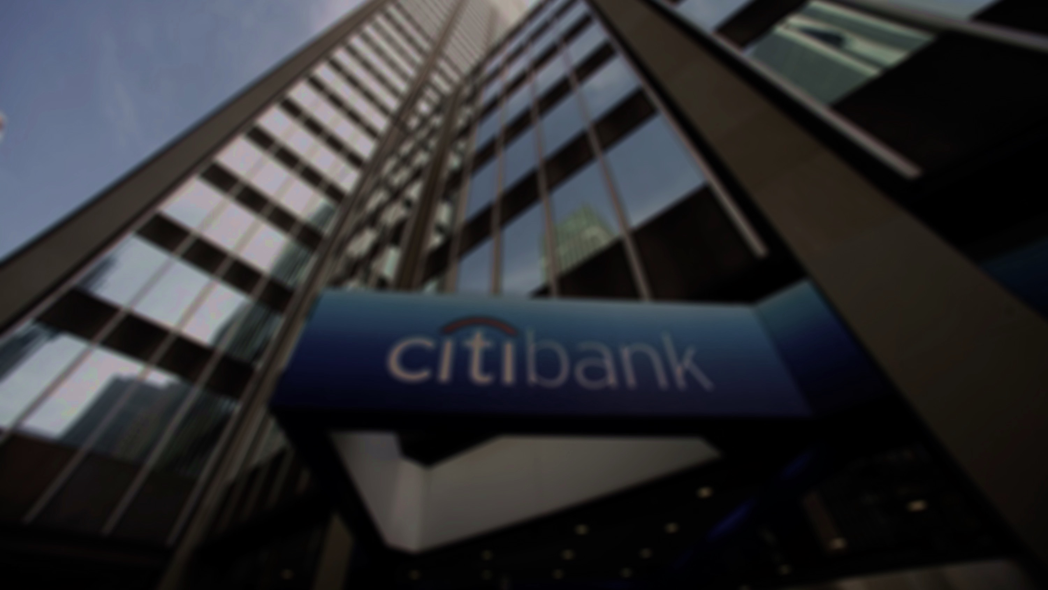

"Over the last 8 months, I'm most proud
that we've released three times
the amount of features."

Slide 9

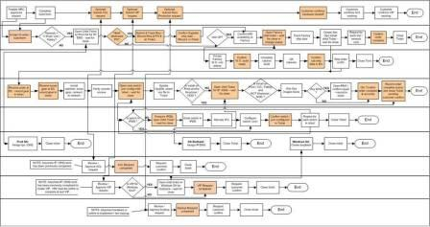
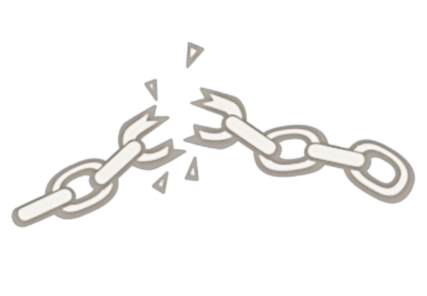
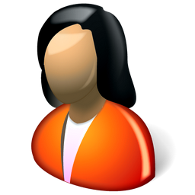
Monolithic Applications Drive Complex, Manual Deploys & Waterfall Release Cycles
Developer
Can you deliver full CI/CD for every major app in your portfolio today, or are you doing 75+ step manual deployments?
Operator
Notes:
We’re working with customers like Comcast and Lockheed Martin who have been struggling to ship software faster. Both in terms of new projects and implementing these modern, DevOps-friendly environments that can handle real continuous delivery.
If you’re doing big project with ‘agile waterfall’ where you use agile development with weekly sprints but have a huge manual process to actually ship every 3-9months.
Disconnect between dev and ops. Throw the code over the wall
… and do it all over again from Dev → Test → Prod on any infrastructure

Slide 10
The Promise of Cloud Native
Deploy new features *daily* to production
Faster Feedback (experiment. Fail Fast.)
Outcome not activity focus (optimize)
Loose Coupling (upgrades and fixes)
Self-service, automated middleware
Free/Cheap horizontal scaling
No Downtime Upgrades
Availability and resiliency

Slide 11
WHAT
Notes:
Now I’d love to open this up for discussion.

Slide 12

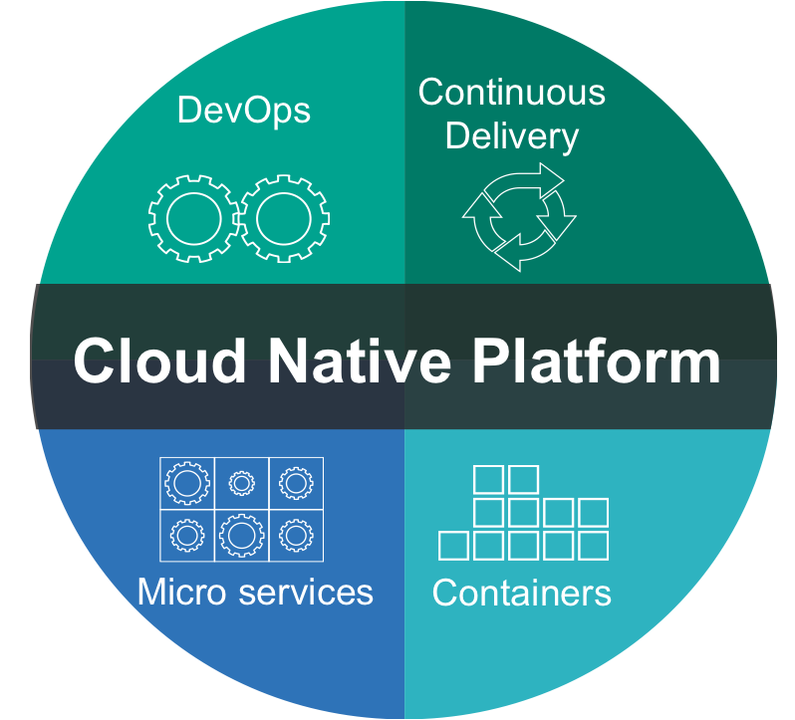
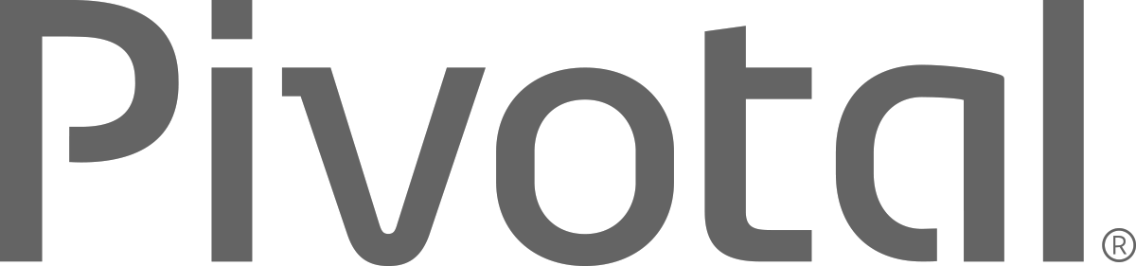
What is Cloud Native?
A term that recognizes that getting software to work in the cloud requires a broad set of components that work together.
It requires an architecture that departs from traditional enterprise application design, such as ‘Microservices’
It requires a Cloud Native platform
Notes:
http://www.informationweek.com/cloud/platform-as-a-service/cloud-native-what-it-means-why-it-matters/d/d-id/1321539

Slide 13
Characteristics of Cloud Native Architectures
Twelve Factor Apps (http://12factor.net/)
Continuously Delivered
Microservices
DevOps
Self-Service agile infrastructure
API-based collaboration
Anti-fragility

Slide 14
Characteristics of Cloud Native Architectures
Twelve Factor Apps (http://12factor.net/)
Continuously Delivered
Microservices
DevOps
Self-Service agile infrastructure
API-based collaboration
Anti-fragility

Slide 15
12-Factor Applications
Codebase
Dependencies
Configuration
Backing Services
Build, release, run
Processes
Port binding
Concurrency
Disposability
Dev/prod parity
Logs
Admin processes
APPS
contract
Cloud Platform
Architectural and development practices – http://12factor.net
Notes:
References:
http://12factor.net/
Architectural and development practices, that ensure an optimal experience on a cloud platform.

Slide 16
Characteristics of Cloud Native Architectures
Twelve Factor Apps (http://12factor.net/)
Continuously Delivered
Microservices
DevOps
Self-Service agile infrastructure
API-based collaboration
Anti-fragility

Slide 17
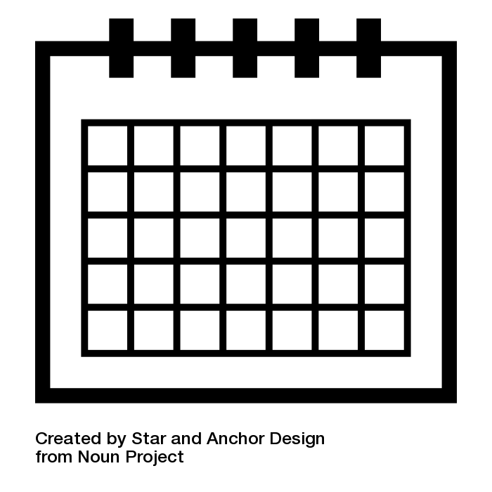
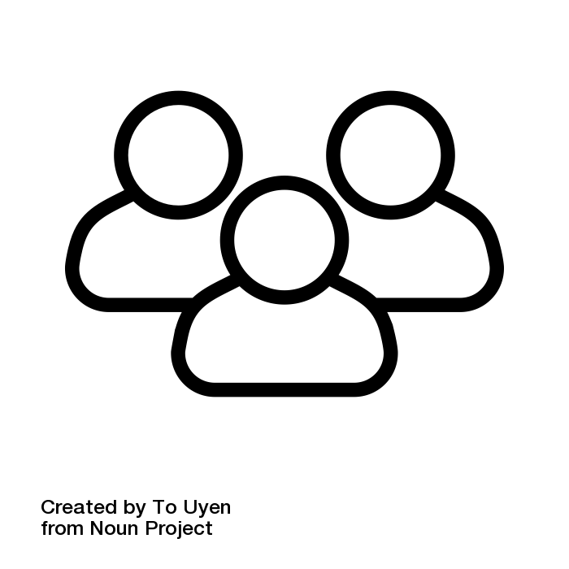
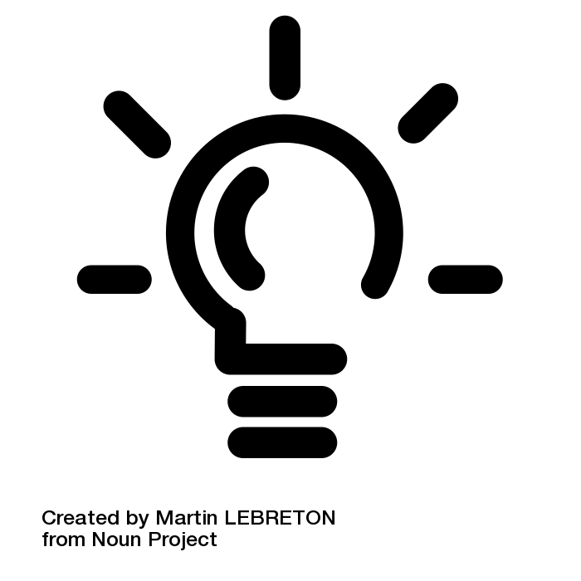
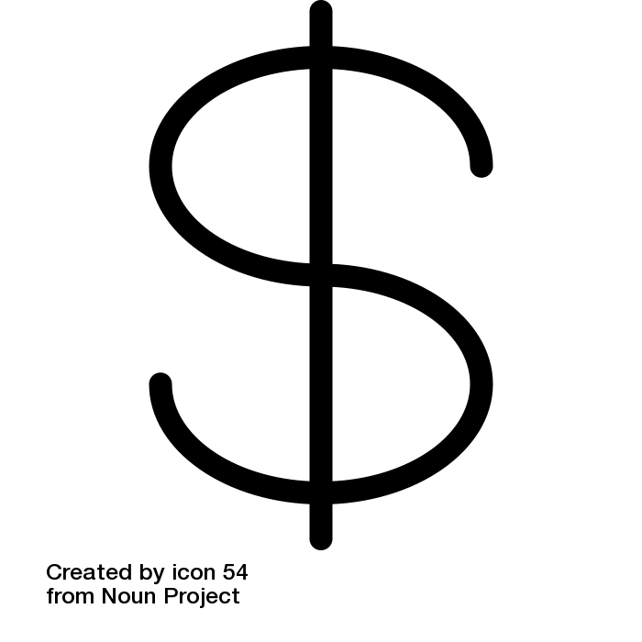
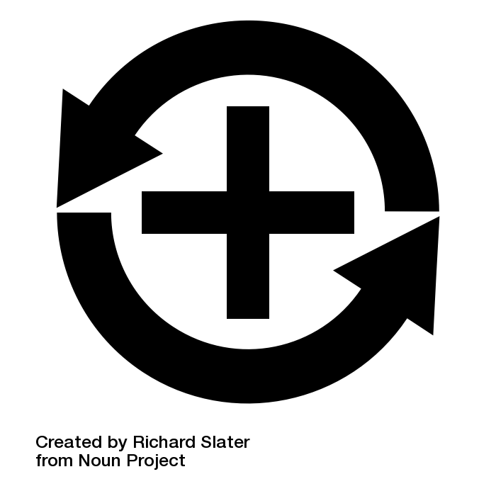
Apps
3+ Months
Plan
Dev
Test
Deploy
Operate
Notes:
Light Bulb by Martin LEBRETON from the Noun Project
multiple users by To Uyen from the Noun Project
dollar sign by icon 54 from the Noun Project
Positive Feedback Loop by Richard Slater from the Noun Project
Calendar by Star and Anchor Design from the Noun Project

Slide 18
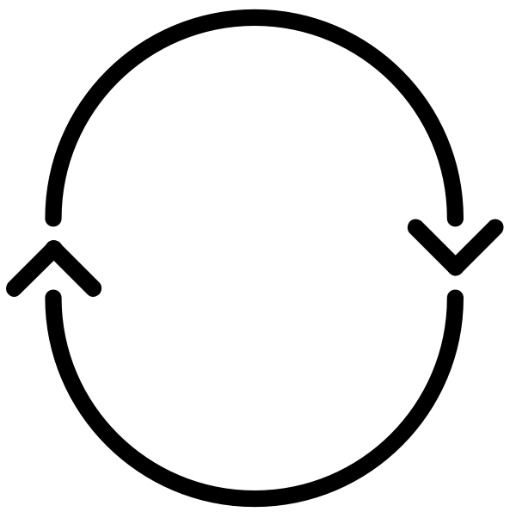
Apps
Agile!
CI
Plan
Dev
Test
Deploy
Operate
CI
-Code
-CI
-Build
-Unit Tests
-Artifact
Notes:
Light Bulb by Martin LEBRETON from the Noun Project
multiple users by To Uyen from the Noun Project
dollar sign by icon 54 from the Noun Project
Positive Feedback Loop by Richard Slater from the Noun Project
Calendar by Star and Anchor Design from the Noun Project
cycle by Chris Jones from the Noun Project

Slide 19
Apps
Water -
Scrum
Agile!
- Fall
3+ Months
CI
Plan
Dev
Test
Deploy
Operate
CI
-Code
-CI
-Build
-Unit Tests
-Artifact
SIT
FT
UAT
Perf
Prod
-H/W & VM
-OS
-Runtime
-Middleware
-Network
-Services
-Config
-Code
-Tests
-H/W & VM
-OS
-Runtime
-Middleware
-Network
-Services
-Config
-Code
-Tests
-H/W & VM
-OS
-Runtime
-Middleware
-Network
-Services
-Config
-Code
-Tests
-H/W & VM
-OS
-Runtime
-Middleware
-Network
-Services
-Config
-Code
-Tests
-H/W & VM
-OS
-Runtime
-Middleware
-Network
-Services
-Config
-Code
-Tests
Inconsistent, Corrupt & Dirty
Notes:
Light Bulb by Martin LEBRETON from the Noun Project
multiple users by To Uyen from the Noun Project
dollar sign by icon 54 from the Noun Project
Positive Feedback Loop by Richard Slater from the Noun Project
Calendar by Star and Anchor Design from the Noun Project
cycle by Chris Jones from the Noun Project

Slide 20
Apps
Agile
CI
CD - Automate
Plan
Dev
Test
Deploy
Operate
CI
-Code
-CI
-Build
-Unit Tests
-Artifact
SIT
FT
UAT
Perf
Prod
-H/W & VM
-OS
-Runtime
-Middleware
-Network
-Services
-Config
-Code
-Tests
-H/W & VM
-OS
-Runtime
-Middleware
-Network
-Services
-Config
-Code
-Tests
-H/W & VM
-OS
-Runtime
-Middleware
-Network
-Services
-Config
-Code
-Tests
-H/W & VM
-OS
-Runtime
-Middleware
-Network
-Services
-Config
-Code
-Tests
-H/W & VM
-OS
-Runtime
-Middleware
-Network
-Services
-Config
-Code
-Tests
Automated Platform
Notes:
Light Bulb by Martin LEBRETON from the Noun Project
multiple users by To Uyen from the Noun Project
dollar sign by icon 54 from the Noun Project
Positive Feedback Loop by Richard Slater from the Noun Project
Calendar by Star and Anchor Design from the Noun Project
cycle by Chris Jones from the Noun Project

Slide 21
Characteristics of Cloud Native Architectures
Twelve Factor Apps (http://12factor.net/)
Continuously Delivered
Microservices
DevOps
Self-Service agile infrastructure
API-based collaboration
Anti-fragility

Slide 22
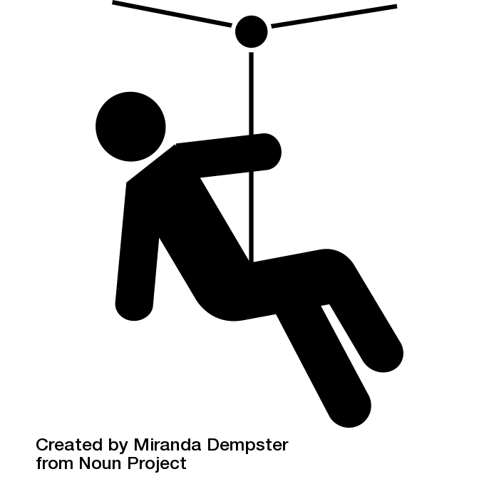
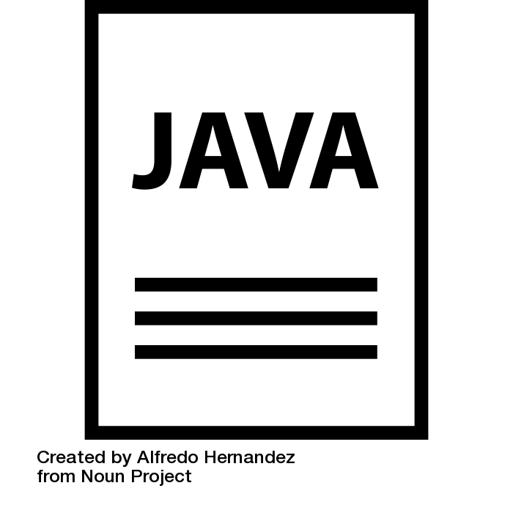
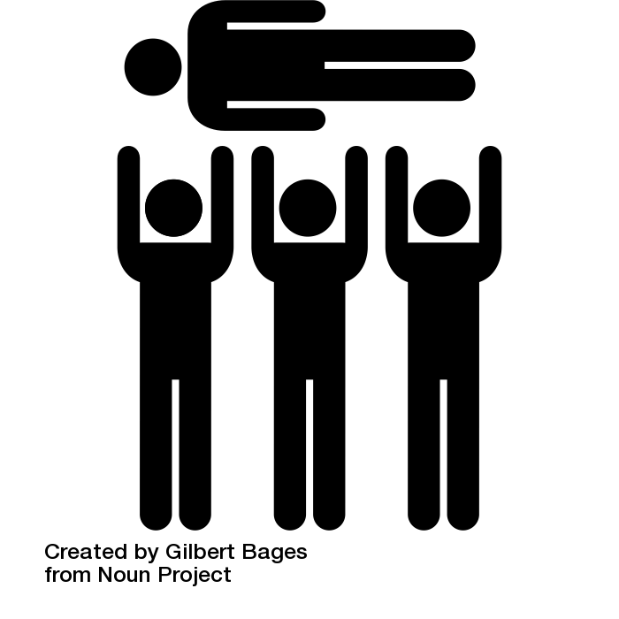
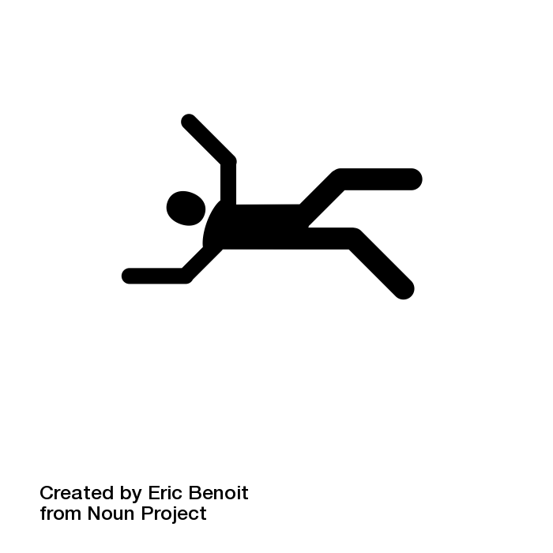
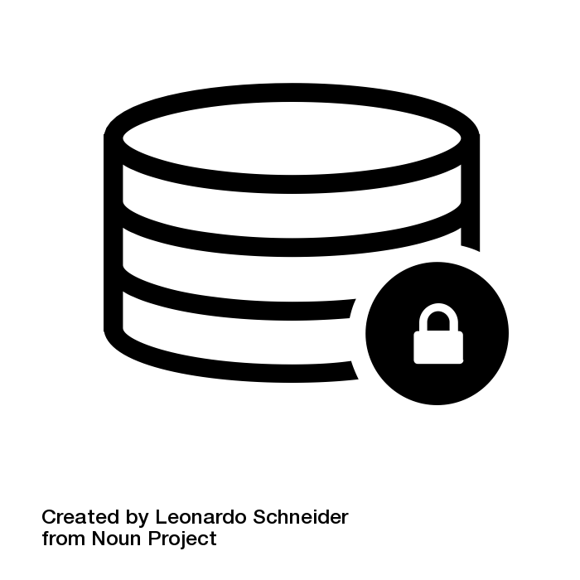
The Monolithic Application
HTML
Java
Script
MVC
X
Service
Service
6+ Months
Data Access
Notes:
Big commitment
falling by Eric Benoit from the Noun Project
Zipline by Miranda Dempster from the Noun Project
Crowd Surfing by Gilbert Bages from the Noun Project
JAVA File by Alfredo Hernandez from the Noun Project
Secure Database by Leonardo Schneider from the Noun Project

Slide 23
What are Microservices?
If every service has to be updated in concert, it’s not loosely coupled!
Loosely coupled service oriented architecture with bounded contexts
If you have to know about surrounding services you don’t have a bounded context.
Notes:
I presume you’re all familiar with microservices and cloud-native, but quickly, here’s an introduction. They’re loosely coupled, service oriented architecture with bounded contexts.
Because each service can be updated independently, your teams can work in parallel. Because each service is isolated, it’s much easier to automate your testing.

Slide 24
Microservices are NOT
Monolithic Application
Service
Service
HTML
JavaScript
MVC
Enterprise Service Bus
Service
Service
OR
Data Access
Service
Service
Tightly Coupled
Centralized

Slide 25
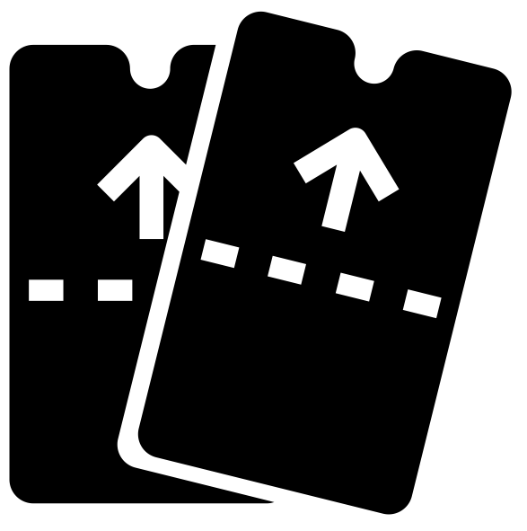
SOA Architecture
Business Change
HTML
JavaScript
MVC
Service
Service
Enterprise Service Bus
Data Access
Notes:
Zipline by Miranda Dempster from the Noun Project
tickets by Kerry Webster from the Noun Project

Slide 26
Trend towards new lightweight architectures
Microservices addressing speed to market and cloud scale
MONOLITHIC/LAYERED
MICROSERVICES
Notes:
Enterprise companies in finance and telco industries are embracing microservice and cloud-native models.
There are new architectures emerging atop these lightweight app servers to address the scale, speed and safety: new ways of tackling cloud scale and speed to market. Microservices has emerged from the internet giants as such an alternative: a change in culture, organization structure and technology that allows teams to work more independently, and increase velocity. It’s a key part of cloud-native applications, which we’ll talk about shortly.
Microservices are both a cultural and organizational change as a change in how we design and implement systems.

Slide 27







Microservice Architecture
Business Change
HTTP
HTTP
HTTP
HTTP
HTTP
HTTP
AMQP
AMQP
…
Relational
DB
Key/Value
Store
Graph
DB
Notes:
REST and message-driven services
Polyglot persistence, services encapsulate data store semantics
Diversity of clients acknowledged
API Gateway for service aggregation, reduce chattiness, protocol translation, reduce latency/round-trips, deal with mobile device fragmentation, build use case/device specific API’s

Slide 28
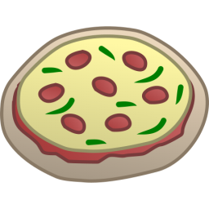
One-Size-Fits-All Methodologies have become an Anti-pattern to the Business
HTML
Java
Script
MVC
Service
Service
Data Access
Monolithic Application
> 2 Pizzas Per Project = Too Many Pizzas

Slide 29
Agile, Disruptive Companies Use Non-traditional, Modular Approaches to Software Systems
Microservice based architecture
Relational
DB
Key/Value
Store
AQMP
…..........
Shared
DB
DB Service
Caching Service
Messaging Service
Two Pizzas Per Microservice = Manageable!
Notes:
To build a Microservices architecture at scale requires a platform

Slide 30
Characteristics of Cloud Native Architectures
Twelve Factor Apps (http://12factor.net/)
Continuously Delivered
Microservices
DevOps
Self-Service agile infrastructure
API-based collaboration
Anti-fragility

Slide 31
Apps
Agile
DevOps
CI
CD - Automate
Plan
Dev
Test
Deploy
Operate
CI
-Code
-CI
-Build
-Unit Tests
-Artifact
SIT
FT
UAT
Perf
Prod
-H/W & VM
-OS
-Runtime
-Middleware
-Network
-Services
-Config
-Code
-Tests
-H/W & VM
-OS
-Runtime
-Middleware
-Network
-Services
-Config
-Code
-Tests
-H/W & VM
-OS
-Runtime
-Middleware
-Network
-Services
-Config
-Code
-Tests
-H/W & VM
-OS
-Runtime
-Middleware
-Network
-Services
-Config
-Code
-Tests
-H/W & VM
-OS
-Runtime
-Middleware
-Network
-Services
-Config
-Code
-Tests
Automated Platform
Notes:
Light Bulb by Martin LEBRETON from the Noun Project
multiple users by To Uyen from the Noun Project
dollar sign by icon 54 from the Noun Project
Positive Feedback Loop by Richard Slater from the Noun Project
Calendar by Star and Anchor Design from the Noun Project
cycle by Chris Jones from the Noun Project

Slide 32
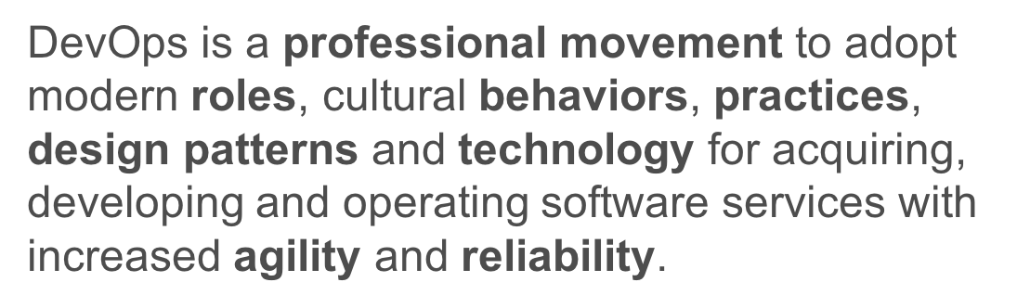

Slide 33
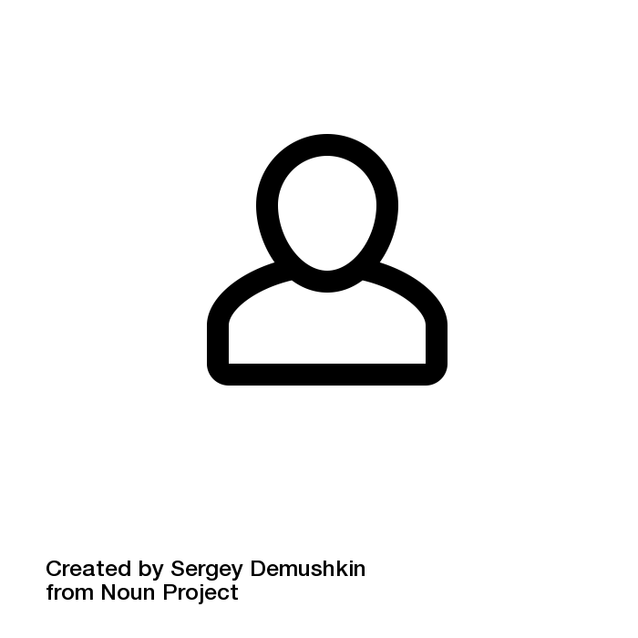
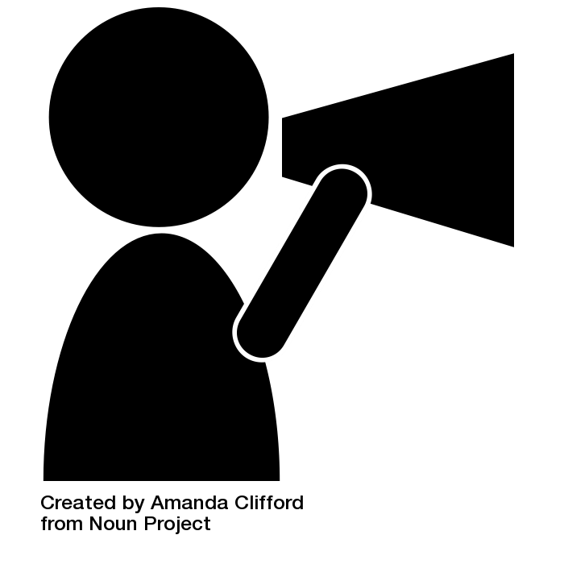
Traditional Org Structures
BO/Product
BO/Product
BO/Product
Arch
UI/Mobile
Services
DBA
Deploy
Infrastructure
OPS
Notes:
User by Sergey Demushkin from the Noun Project
Announcement by Amanda Clifford from the Noun Project

Slide 34
Conway’s Law
“Any organization that designs a system (defined broadly) will produce a design whose structure is a copy of the organization's communication structure.”
- Melvin Conway, 1967
http://www.melconway.com/Home/Committees_Paper.html
Notes:
Inverse Conway Maneuver coined by Thoughtworks - http://jonnyleroy.com/2011/02/03/dealing-with-creaky-legacy-platforms/
Goal is to create self contained, business aligned teams with the smallest feedback loop.
Business capability teams interact with platform operations team via APIs and not meetings. This creates a friction free experience for the business capability team who now have the tools to

Slide 35
Agile Org Structures
BO/Product
BO/Product
BO/Product
Arch
UI/Mobile
Services
DBA
Deploy
Infrastructure
OPS
Notes:
User by Sergey Demushkin from the Noun Project
Announcement by Amanda Clifford from the Noun Project

Slide 36
Inverse Conway Maneuver Enable Continuous Delivery
Product Mgr.
Dev
UX
QA
DBA
Self
Service
APIS
Sys Admin
Network Admin
Storage Admin
Business Capabilities Team Using Microservices
Platform Operations Team
http://jonnyleroy.com/2011/02/03/dealing-with-creaky-legacy-platforms/
http://www.slideshare.net/adriancockcroft/microservices-the-good-bad-and-the-ugly
Notes:
References:
Inverse Conway Maneuver coined by Thoughtworks - http://jonnyleroy.com/2011/02/03/dealing-with-creaky-legacy-platforms/
http://www.slideshare.net/adriancockcroft/microservices-the-good-bad-and-the-ugly
Notes:
Goal is to create self contained, business aligned teams with the smallest feedback loop.
Business capability teams interact with platform operations team via APIs and not meetings. This creates a friction free experience for the business capability team who now have the tools to

Slide 37
Enabling Continous Delivery of Microservices
Production Release
ORDERS
Production Release
Production Release
SHIPPING
Production Release

Slide 38
Characteristics of Cloud Native Architectures
Continuously Delivered
DevOps
Twelve Factor Apps (http://12factor.net/)
Microservices
Self-Service agile infrastructure
API-based collaboration
Anti-fragility

Slide 39
Characteristics of Cloud Native Architectures
Continuously Delivered
DevOps
Twelve Factor Apps (http://12factor.net/)
Microservices
Self-Service agile infrastructure
API-based collaboration
Anti-fragility

Slide 40
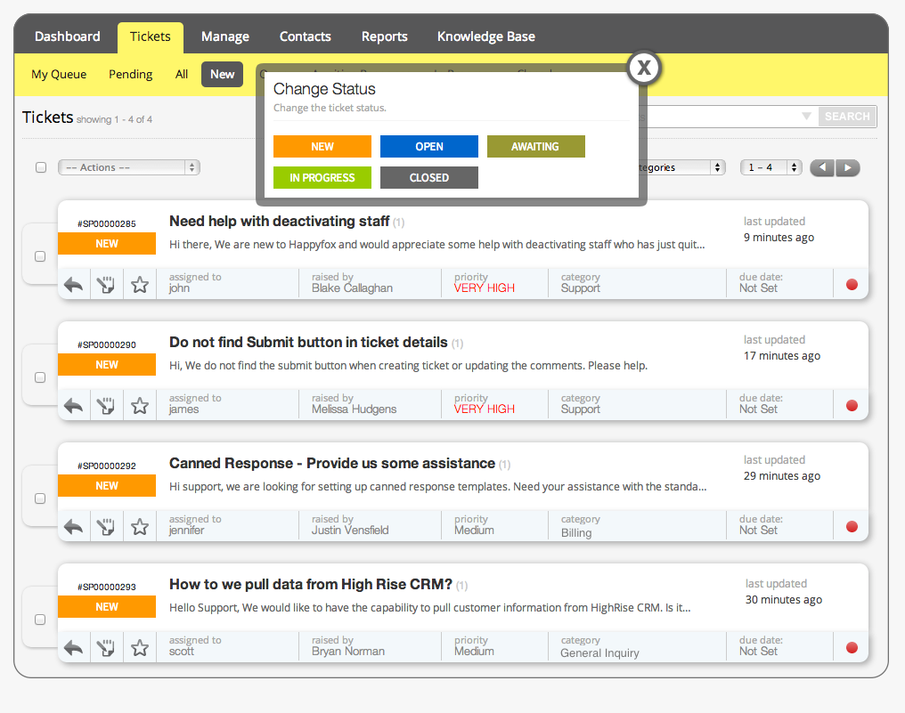

Slide 41
Characteristics of Cloud Native Architectures
Continuously Delivered
DevOps
Twelve Factor Apps (http://12factor.net/)
Microservices
Self-Service agile infrastructure
API-based collaboration
Anti-fragility

Slide 42
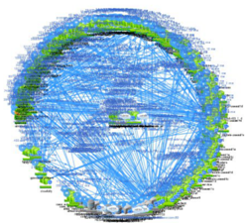
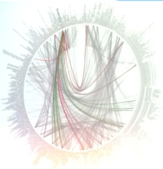
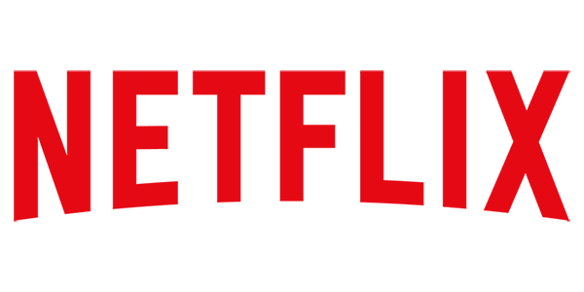
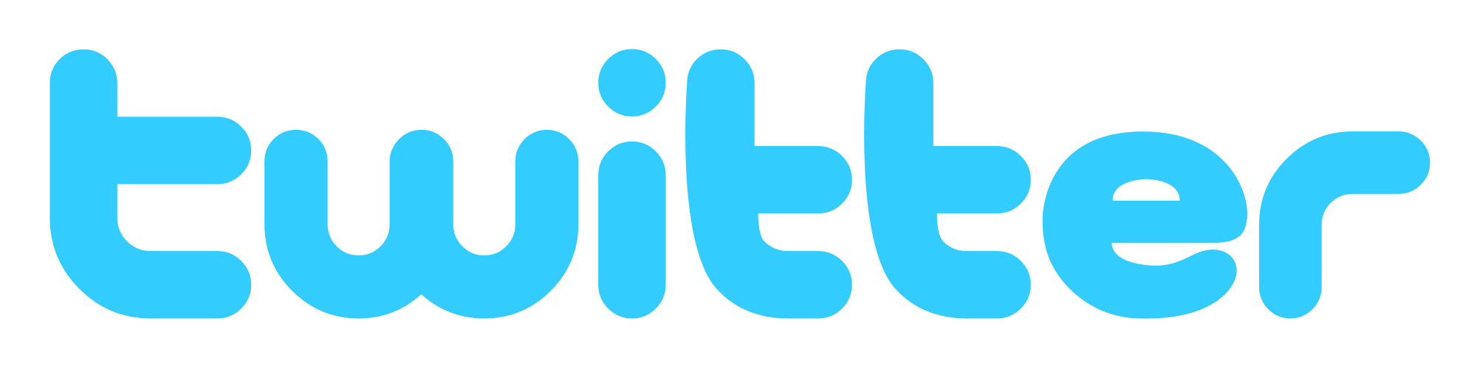
However… Microservices are Hard
Discovery
User Management
Failover and HA
Configuration
Security
API Management
Monitoring & Logging

Slide 43
HOW
Notes:
Now I’d love to open this up for discussion.

Slide 44
It Takes a Platform
An end-to-end platform that makes implementing distributed application best practices, a turn-key and first practice
Notes:
Inverse Conway Maneuver coined by Thoughtworks - http://jonnyleroy.com/2011/02/03/dealing-with-creaky-legacy-platforms/
Goal is to create self contained, business aligned teams with the smallest feedback loop.
Business capability teams interact with platform operations team via APIs and not meetings. This creates a friction free experience for the business capability team who now have the tools to

Slide 45
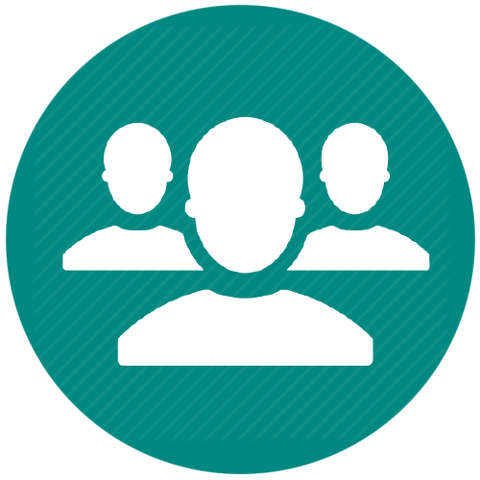
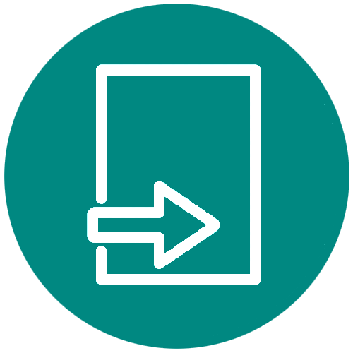



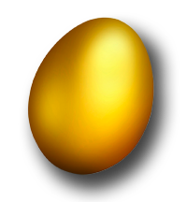

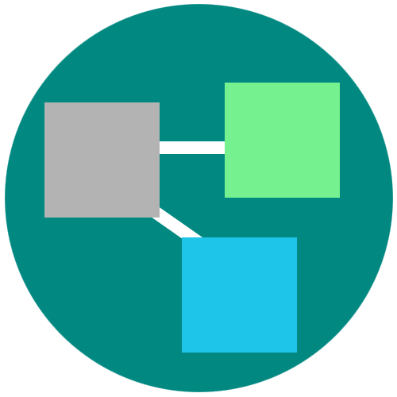
Cloud Foundry: An Application-centric Platform
Roles and Policy
Log aggregation
Security and Isolation
APM
Scaling
APPLICATION
Health management
Blue green deployment
Notes:
Discuss how the platform provides tools to simplify many operational tasks.

Slide 46


Cloud Foundry Haiku
Here is my source code
Run it on the cloud for me
I do not care how
Notes:
Best way to summarize cloud foundary experience for developers. Here is the famous CFH.
a Japanese poem of seventeen syllables, in three lines of five, seven, and five

Slide 47


D E M O
Notes:
Go to start.spring.io and create an app
Discuss the Gradle/Maven file dependencies

Slide 48

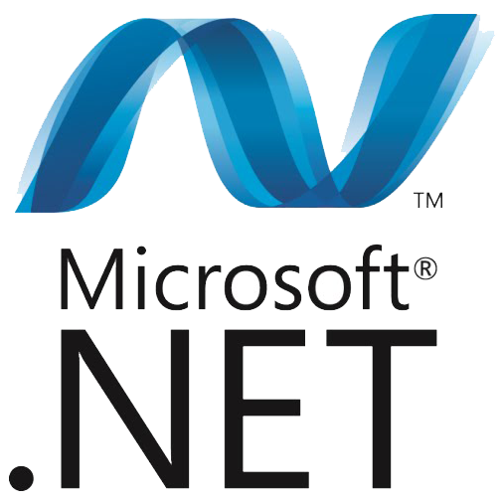


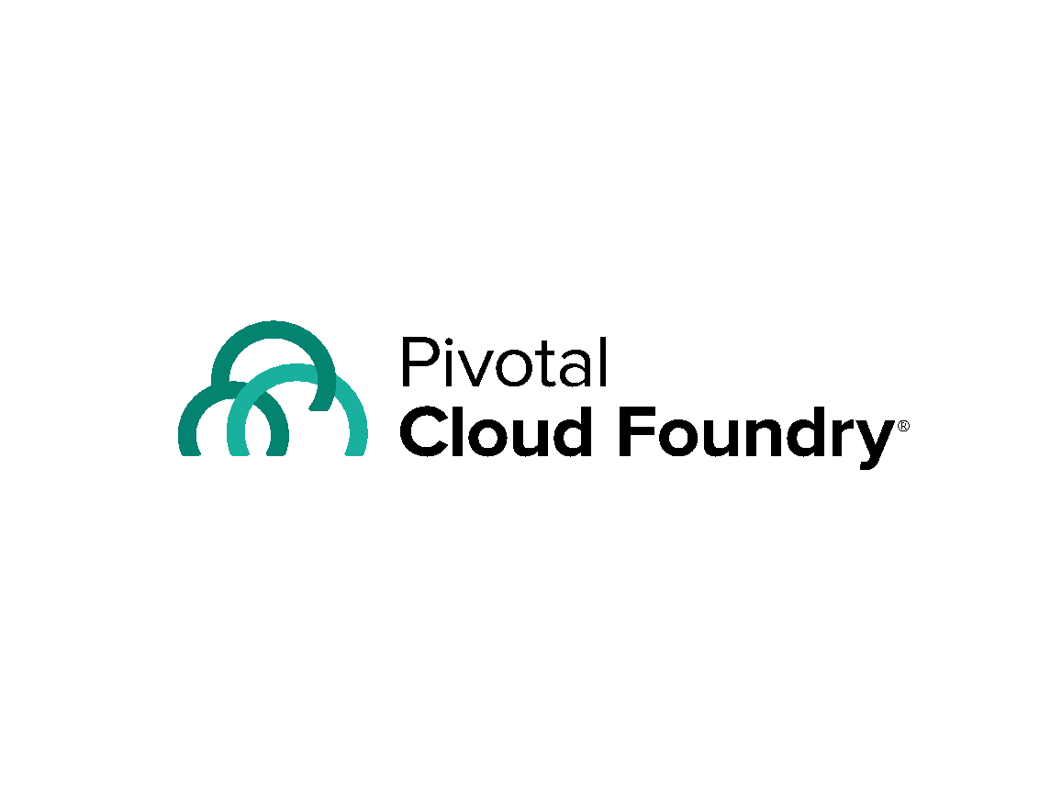
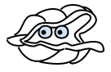





Cloud Native Platform and Contracts
Culture
Framework
Tools
Application Framework
Dev
.NET
Spring Boot
Contract: 12 Factor App
Runtime Platform
Pivotal
Cloud Foundry
Dev
IT Ops
Contract: BOSH Release
Infrastructure Automation
BOSH
IT Ops
Contract: Cloud Provider Interface
Infrastructure
Azure
IT Ops
Notes:
And all of this is enforced through strict API contracts that allow you to go FAST and be safe.

Slide 49

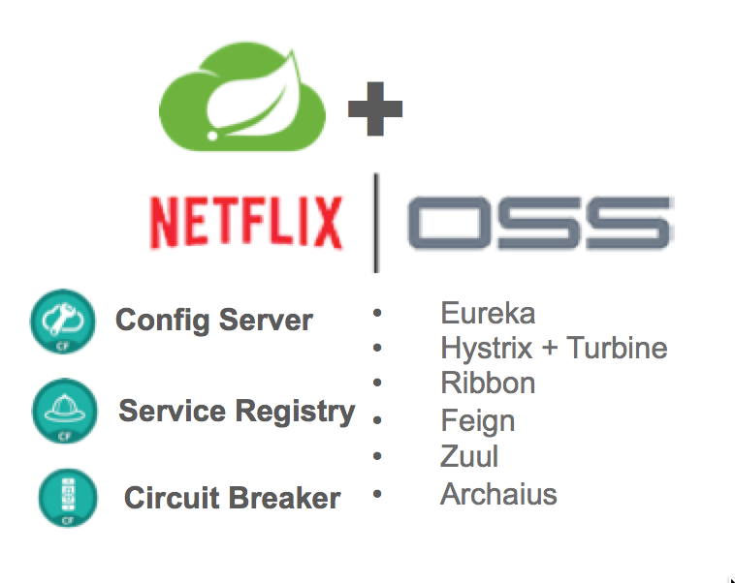

Application Framework
Spring Cloud
Spring Boot
Dev
Spring Boot
From 0 to app in < 5 min
Spring Boot provides
A single point of focus (as opposed to large collection of spring-* projects)
Prebuild “starters”
Common non-functional requirements for a “real” application
Exposes a lot of useful features by default
Gets out of the way quickly if you want to change defaults
Notes:
This month alone, there were over 1.6m downloads, 8m YTD, growing at 10% m/o/m key new projects. Why? because developers love Boot - It’s zero config, super lightweight, runtime ideal for single purpose single process applications aka microservices. With Boot you can go from 0 to app in <5minutes
But remember the concept of fragile infrastructure and designing for failure? How do you wire up all these little processes into a cohesive app that works even when things go wrong?
Luckily Netflix has solved some of these problems at web scale ( their OSS stack is great, but not so easy to use). Swe took that core functionality and built spring cloud. All the power of eureka, hysterix, and config server built as spring modules. As easy adding an annotation and secure for the enteprrise
So awesome even netflix is using it now now we have the app devs able to run super fast and make lots of microservices and tie them together to make amazing apps with spring boot and cloud
But this actually created a huge ops problem …..

